Slide 1
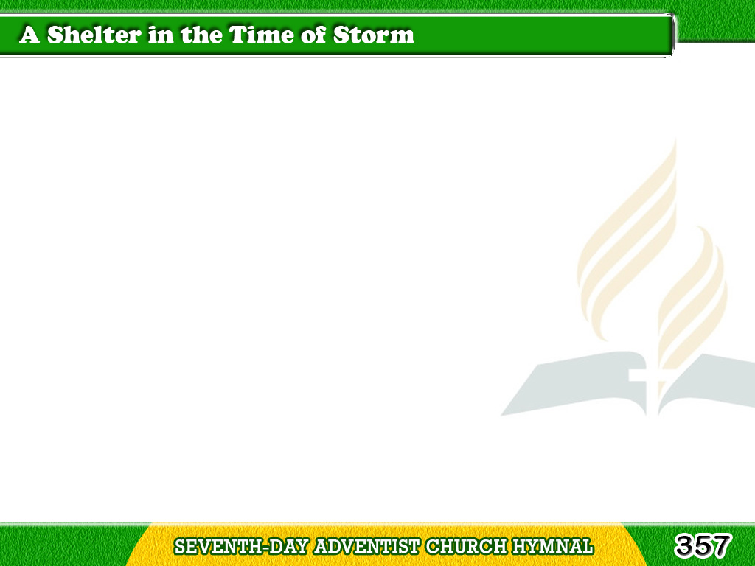
1/4
The Lord’s our Rock,
in Him we hide,
A shelter in the time of storm;
Secure whatever may betide,
A shelter in the time of storm.
Tagalog
Version

Slide 2
1/4
Chorus
Mighty Rock in a weary land,
Cooling shade
on the burning sand,
Faithful guide for the pilgrim band
A shelter in the time of storm.
Tagalog
Version

Slide 3
2/4
A shade by day, defense by night,
A shelter in the time of storm;
No fears alarm, no foes affright,
A shelter in the time of storm.
Tagalog
Version

Slide 4
2/4
Chorus
Mighty Rock in a weary land,
Cooling shade
on the burning sand,
Faithful guide for the pilgrim band
A shelter in the time of storm.
Tagalog
Version

Slide 5
3/4
The raging floods
may round us beat,
A shelter in the time of storm;
We find in God a safe retreat,
A shelter in the time of storm.
Tagalog
Version

Slide 6
3/4
Chorus
Mighty Rock in a weary land,
Cooling shade
on the burning sand,
Faithful guide for the pilgrim band
A shelter in the time of storm.
Tagalog
Version

Slide 7
4/4
O Rock divine, O Refuge dear,
A shelter in the time of storm;
Be Thou our helper, ever near,
A shelter in the time of storm.
Tagalog
Version

Slide 8
4/4
Chorus
Mighty Rock in a weary land,
Cooling shade
on the burning sand,
Faithful guide for the pilgrim band
A shelter in the time of storm.
Tagalog
Version

